Slide 1
THE SPEAR PROJECT
Phishing Awareness and Training.
ANAELE EMMANUEL.

Slide 2
TRAINING OUTLINES
FAMILIARIZE YOURSELF WITH PHISHING: Phishing presentation goal.
INTRODUCTION TO PHISHING
FACTS ABOUT PHISHING
TYPES OF PHISHING ATTACKS
HOW PHISHING WORKS
PHISHING ATTEMPTS: E.G LEARN TO SPOT PHISHING EMAILS
ALWAYS BE CAUTIOUS - ADVANCED SOPHISTICATION EMAILS
HOW DO WE STOP GETTING PHISHED?
REMEMBER TO ALWAYS
CONCLUSION

Slide 3
PHISHING PRESENTATION GOAL
1
Identifying red flags:
Teach individuals to recognize common signs of phishing emails like suspicious sender addresses, urgent requests, grammatical errors, and unusual links.

Slide 4
2
Raising awareness:
Educate users on the dangers of phishing attacks and how they can be targeted

Slide 5
3
Safe practices:
Promote best practices like verifying sender legitimacy, not clicking on suspicious links, and never sharing personal information on untrusted websites and emails.

Slide 6
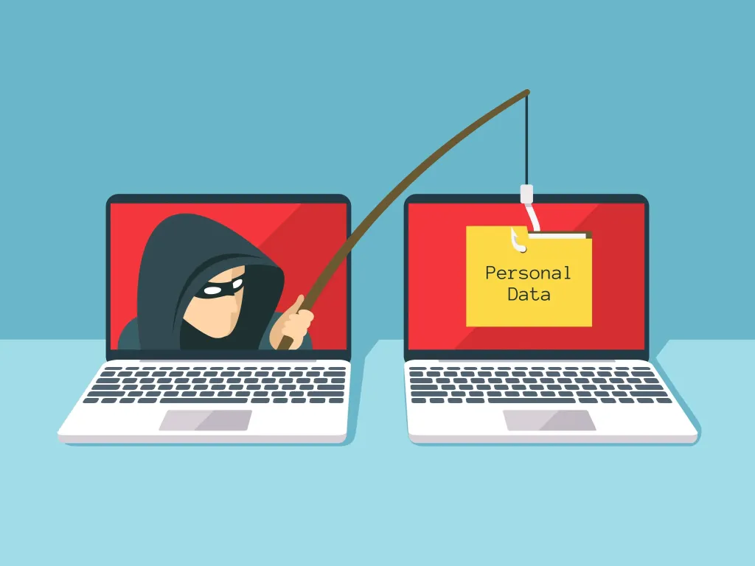
INTRODUCTION TO PHISHING
What is phishing?
Phishing is the act of pretending to be someone, or something, to get information not usually available.
People can be gullible and curious and click on things they shouldn’t - often a link will direct to a fake login page in an attempt to steal credentials.
Attackers often pose as a trusted source, such as a company or individual, and send deceptive emails, text messages, or phone calls. The goal is to get the victim to take a specific action, like clicking a link or sharing personal information.

Slide 7
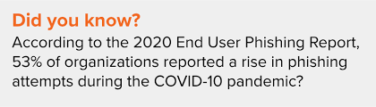
FACTS ABOUT PHISHING
An interesting fact about phishing is that it is considered the most common form of cybercrime, with estimates suggesting that around 3.4 billion malicious emails are sent every day, making it a widespread threat across the internet; essentially, "fishing" for sensitive information from users through deceptive emails.

Slide 8


SPEAR PHISHING: A spear phishing attack is a highly targeted form of phishing where cybercriminals send personalized emails to specific individuals or organizations, using information gathered about the target to craft a convincing message designed to trick them into revealing sensitive data, downloading malware, or taking other harmful actions, often by pretending to be a trusted source like a colleague or company executive; essentially, it's a phishing attack that is specifically tailored to a single person or group, making it much more likely to succeed than a generic phishing email.
TYPES OF PHISHING ATTACKS

Slide 9
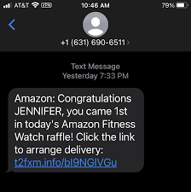
SMS PHISHING: A spear phishing attack is a highly targeted form of phishing where cybercriminals send personalized emails to specific individuals or organizations, using information gathered about the target to craft a convincing message designed to trick them into revealing sensitive data, downloading malware, or taking other harmful actions, often by pretending to be a trusted source like a colleague or company executive; essentially, it's a phishing attack that is specifically tailored to a single person or group, making it much more likely to succeed than a generic phishing email.

Slide 10
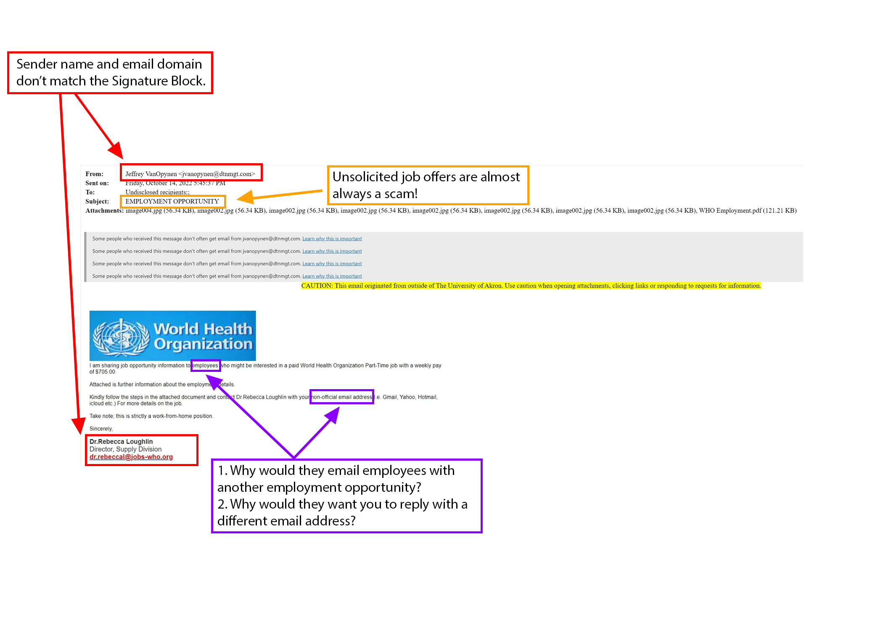
PHISHING ATTEMPTS: LEARN TO SPOT PHISHING EMAILS

Slide 11
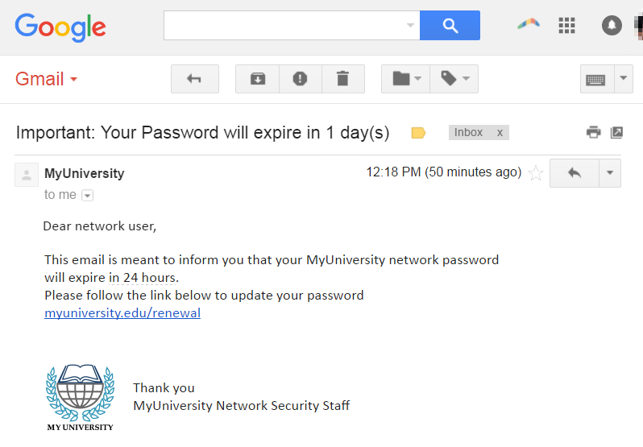
ALWAYS BE CAUTIOUS - THEY CAN BE SOPHISTICATED AS THIS

Slide 12
HOW DO WE STOP GETTING PHISHED?
If it’s too good to be true it probably is.
Always be suspicious. Better safe than sorry.
Double check with other employees on a separate communication channel, For example, in the university phishing email, you could confirm by calling the University to confirm about the link being sent out before clicking on the email.

Slide 13
REMEMBER TO ALWAYS:
Check the URL of the website is correct.
Always be suspicious of any email requesting personal information.
Use a password manager to securely store unique passwords for each website.
Use a secondary/side channel to double check when someone requests you to do something.

Slide 14
CONCLUSION
In conclusion, phishing is a complex online threat with diverse tactics and significant implications for user security and data integrity. We should be careful and vigilant of our online activities because it can be a trap to attract hackers and threat actors.

Slide 15
Thanks CODEALPHA!
Do you have any questions?
matthewemmanuel007@gmail.com | +23408186780037 | /www.linkedin.com/in/anaeleemmanuel

